Slide 1
Chapter 20: Designing an Architecture
A designer knows he has achieved perfection not when there is nothing left to add, but when there is nothing left to take away. —Antoine de Saint-Exupéry

Slide 2
Chapter Outline
Attribute-Driven Design
The Steps of ADD
Choosing Design Concepts
Producing Structures
Creating Preliminary Documentation
Performing Analysis
Summary

Slide 3
Attribute-Driven Design
Architecture design is notoriously difficult to master
Design can (and should) be performed in a systematic way.
Design decisions should be justified.
The architect is accountable for design decisions
A systematic method provides guidance in performing this complex activity so that it can be learned and capably performed by mere mortals.

Slide 4
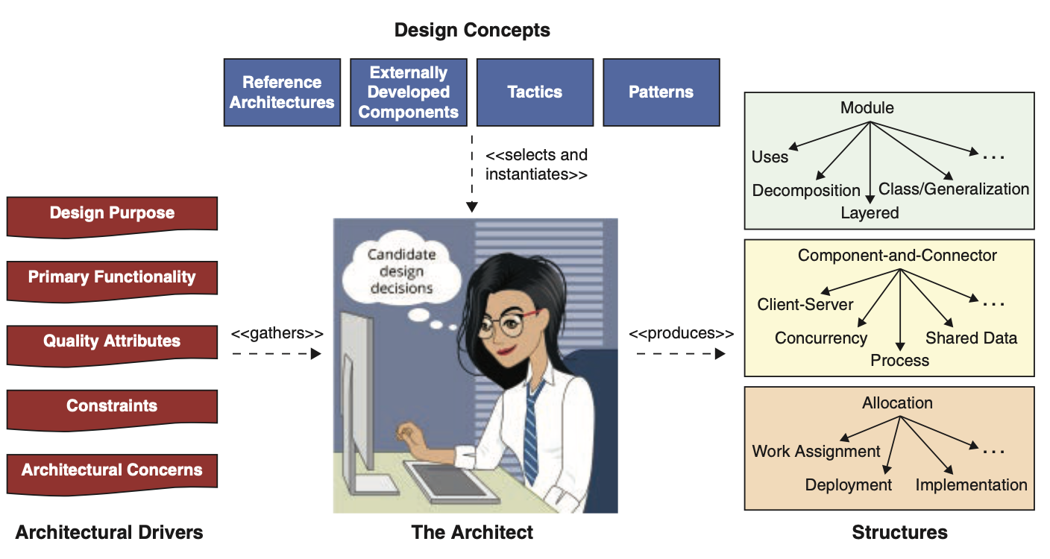
Attribute-Driven Design
Architectural design involves making decisions, and working with the available materials and skills, to satisfy requirements and constraints.
In architectural design, we turn drivers into structures.

Slide 5
Attribute-Driven Design
Architectural drivers comprise architecturally significant requirements (ASRs—the topic of Chapter 19), but also include functionality, constraints, architectural concerns, and design purpose.
The resulting structures guide analysis, implementation, and much more (remember Chapter 2?).

Slide 6
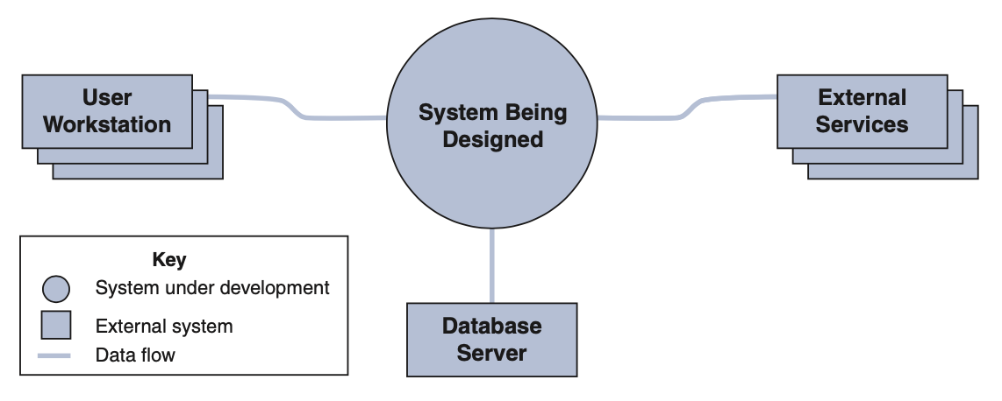
Attribute-Driven Design
Prior to starting design, you need to determine the scope of the system— what is in and what is out, and which external entities your system will interact with.
This can be represented as a context diagram.

Slide 7
The Steps of ADD
In ADD, architecture design is performed in iterations.
Within each iteration, a series of design steps is performed.

Slide 8
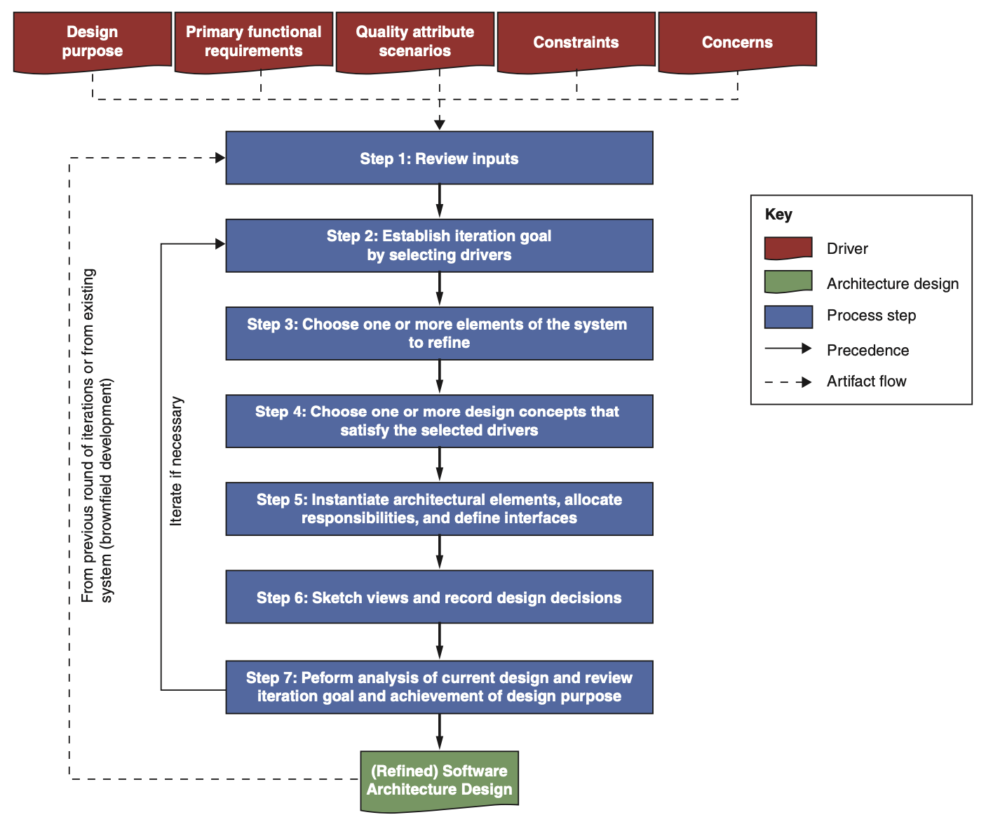
The Steps of ADD

Slide 9
Step 1: Review Inputs
Before starting a design round, you need to ensure that the architectural drivers (the inputs to the design process) are available and correct. These include:
The purpose of the design round
The primary functional requirements
The primary quality attribute (QA) scenarios
Any constraints
Any concerns

Slide 10
Step 2: Establish Iteration Goal by Selecting Drivers
Each design iteration focuses on achieving a particular goal--to satisfy a subset of the drivers.
When doing design, you need to establish a goal before you start an iteration.

Slide 11
Step 3: Choose One or More Elements of the System to Refine
Every design decision is manifested as a set of elements, relationship, and properties of architectural structures.
For existing systems (or later design iterations in greenfield systems) you refine elements that were identified in prior iterations.
When designing a greenfield system you may select a particular element and the associated drivers that you want to address.

Slide 12
Step 4: Choose One or More Design Concepts That Satisfy the Selected Drivers
Choosing the design concept(s) is probably the most difficult decision in design.
Many different types of design concepts are available—tactics, patterns, reference architectures, and externally developed components—and for each type there are many options.

Slide 13
Step 5: Instantiate Architectural Elements, Allocate Responsibilities, Define Interfaces
Once you have selected one or more design concepts, you must make another type of design decision: how to instantiate elements out of the design concepts that you just selected.
After instantiating the elements, you then need to allocate responsibilities to each of them.

Slide 14
Step 6: Sketch Views and Record Design Decisions
At this point, you have finished performing the design activities for the iteration.
Now you should ensure that the views—the representations of the structures you created—are preserved.
You should also record any significant decisions made in the design iteration, as well as the rationale, to facilitate later analysis and understanding of the decisions

Slide 15
Step 7: Perform Analysis of Design, Review Iteration Goal, and Design Purpose
By now, you have created a partial design that addresses the goals established for the iteration.
Making sure that this is actually the case is a good idea, to avoid unhappy stakeholders and later rework.
Once the design performed in the iteration has been analyzed, you should review the state of your architecture in terms of your established design purpose.

Slide 16
Iterate If Necessary
You should perform additional iterations and repeat steps 2–7 for every driver that was considered.
More often than not this kind of repetition will not be possible because of time or resource constraints.
What are the criteria for evaluating if more design iterations are necessary? Let risk be your guide.

Slide 17
Choosing Design Concepts
Most of the time you, as an architect, don’t need to, and should not, reinvent the wheel.
Your major design activity is to identify and select design concepts to address drivers.
This is the hardest part of design.

Slide 18
Identifying Design Concepts
So how to choose a design concept?
The identification of design concepts might appear daunting, because of the vast number of options available, scattered across many blogs, and websites, and in books.
So … what to do?
Leverage existing best practices.
Leverage your own knowledge and experience
Leverage the knowledge and experience of others

Slide 19
Selecting Design Concepts
Once you have identified a list of alternative design concepts, you need to select.
You might create a table that lists the pros and cons of each alternative. This table could contain cost information.
Methods such as SWOT (strengths, weaknesses, opportunities, threats) analysis can help you here.
Decisions that you made in previous iterations may restrict the concepts you can now select.

Slide 20
Creation of Prototypes
Often you will need to create prototypes to determine the properties of technologies.
When thinking about whether you should create a prototype, ask these questions:
Does the project incorporate emerging technologies?
Is the technology new in the company?
Are there certain drivers, particularly QAs, whose satisfaction using the selected technology presents risks?
Is there a lack of trusted information that would provide some certainty that the selected technology will be useful to satisfy the project drivers?
Are there configuration options associated with the technology that need to be tested or understood?
Is it unclear whether the selected technology can be easily integrated with other technologies that are used in the project?

Slide 21
Producing Structures
Design concepts won’t help you unless you produce structures.
This is the “instantiation” phase for architectural elements in ADD: creating elements and relationships, and associating responsibilities with them.
When you instantiate a design concept, you may actually affect more than one structure.

Slide 22
Associating Responsibilities and Identifying Properties
When you are creating elements (instantiating design concepts) you need to consider the responsibilities allocated to them.
Elements should have high cohesion (internally), a narrow set of responsibilities, and low (external) coupling.
And you need to consider the properties of the elements.

Slide 23
Defining Relationships and Interfaces
The creation of structures also requires making decisions with respect to the relationships that exist between the elements and their properties.
Interfaces establish a contractual specification that allows elements to collaborate and exchange information.

Slide 24
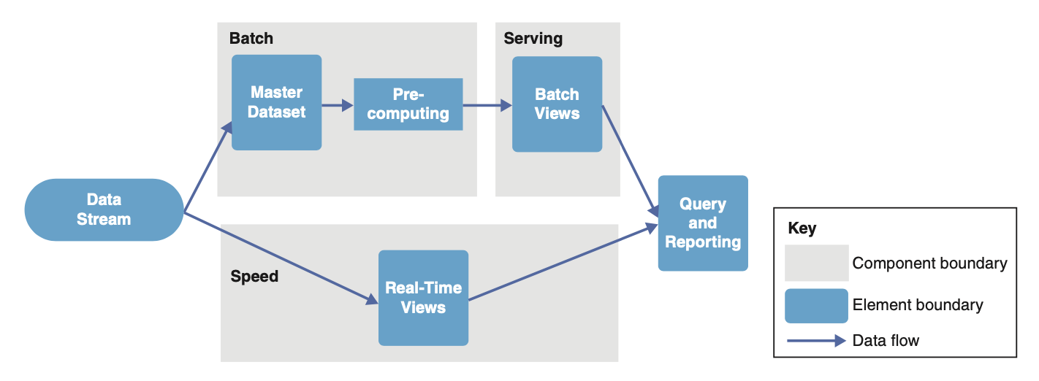
Creating Preliminary Documentation
The formal documentation of views is not part of ADD.
Structures, however, are naturally produced as part of design.
Capture them, even if they are represented informally (as sketches).
This requires some discipline.
The benefits are worth it, as you will be able to more easily produce detailed architecture documentation later.

Slide 25
Recording Design Decisions
When you see an architectural diagram, you see the end product but can’t always understand the decisions made to achieve this result.
Recording design decisions beyond the elements, relationships, and properties is fundamental to clarify how you arrived at the result—your design rationale.

Slide 26
Perform Analysis of the Design, Review the Iteration Goals
At the end of an iteration, it is prudent to do some analysis to reflect on the decisions you just made.
One kind of analysis that you need to perform at this point is to assess whether you have done enough design work. In particular:
How much design do you need to do?
How much design have you done so far?
Are you finished?

Slide 27
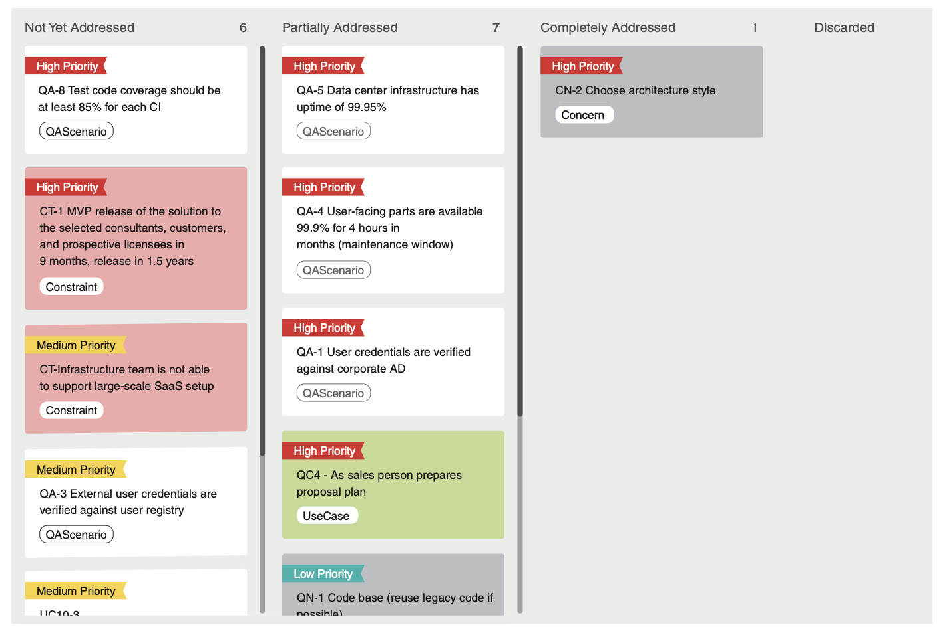
Perform Analysis of the Design, Review the Iteration Goals
Practices such as the use of backlogs and Kanban boards can help you track the design progress and answer these questions.

Slide 28
Summary
Design is hard.
Methods are needed to make it more tractable (and repeatable).
The ADD method allows an architecture to be designed in a systematic and cost-effective way.

